Slide 1
Deception Blueprint
Subtitle goes here
—
Date

Slide 2
Agenda
 | Page
1. - | 4

Slide 3
Introduction
This deck will detail the steps to be taken when looking into deception for a client organisation. Depending on the scope of work you may be asked to design a deception use cases, pitch new tooling as well as design and oversee an implementation of a selected tool.
This document is not intended to cover all eventualities but to act as a rough guid when approaching a DLP focussed workstream or engagement.

Slide 4
1. Discovery

Slide 5
Questions for Stakeholders
Begin by meeting with stakeholders and gaining an overview of the deception capability within the client organisation and areas they would like to target for additional protection. The below questions and documentation requests should be key points to focus on in these meetings. This list Is not exhaustive and you will need to ask additional tailored questions as you discover more about the organisation.
Workshop questions for stakeholders
Can you give an overview of your current security tooling?
What, if any deception technologies do you have currently implemented?
Do you have any security tooling with deception capabilities, even if they are not currently in use?
What areas of your network are you looking to protect the most?
Do you have any specific targets you want to protect using deception?
What attack vectors/ use cases are you looking to defend against using deception?
What are your crown jewels and where on your network are they located?
Are you interested in a commercial or open source tooling solution?
Documentation requests
Technical documentation on any deception tooling the client currently has in place
Network topography diagrams

Slide 6
2. Use Cases

Slide 7
Use Cases
Once you have completed the discovery phase you should begin working on the use cases you want to target. This will help inform the tooling selection and placement within the network in later stages. You should have determined what attack vectors the client is most concerned about during the discovery phase. You can use these attack methods/vectors to create the use cases. These should be tailored to the client current security tooling for easy integration.
You can start by mapping the attack vectors using the MITRE Att&ck framework. This is an industry standard that can be used for easy reference to
Please Note: Document classification is not to be removed.

Slide 8
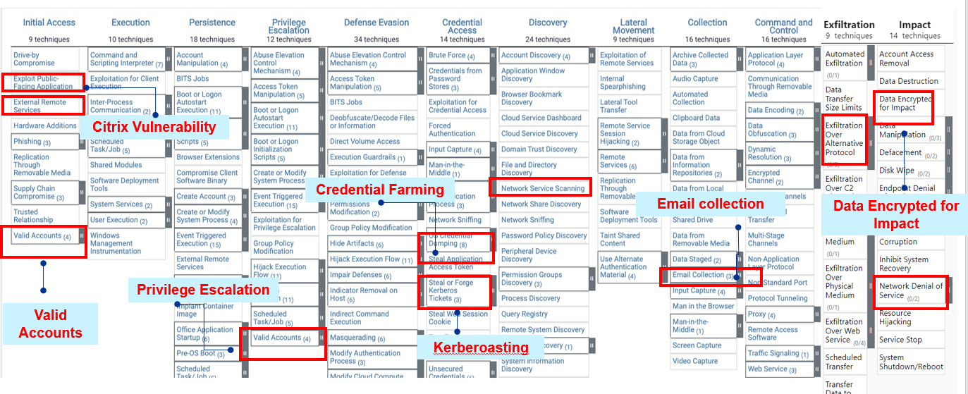
MITRE ATT&CK Mapping
You can start by mapping the attack vectors you identified in the discovery phase using the MITRE Att&ck framework. This is an industry standard that can be used for easy reference and to gain more information about attack methods and their various uses.

Slide 9
Deception Techniques
Once you have identified and mapped the attack vectors and methods you want to target, you can next map them to specific targets within the client network and the deception methods that can be used to protect them.
Deception is a relatively new field within cybersecurity that focusses on detecting threats early with a low rate of false positives. This is done by deploying convincing decoys within a network for attackers to interact with, rather than their actual targets. Attackers can be lead to these decoys by lures left scattered around the network. Some solutions may imitate entire sections of a network in order to convince attackers they are interacting with legitimate targets.
You should conduct research around specific deception techniques to counter the attack vectors you are targeting. The table below is an example of mapping specific targets, attack methods and deception techniques.
Attack Surface/Target | Attacks | MITRE TTPS | Deception Techniques
DMS | Data encryption Data exfiltration | T1048: Exfiltration over alternative protocols T1471:Data encrypted for impact | Decoy Data Responses
AD | Pass the Ticket Kerberoasting | TA0004: Privilege Escalation T1558.003: Kerberoasting | Decoy User Accounts Fake user/service accounts and credentials
Endpoints | Ransomware, unauthorized access User accounts, Access of sensitive files Registry changes Citrix CVE-2023-4966 | TA0003: Host compromise and persistence T1114.001: Local Email collection | Fake Servers (Linux, Windows) Citrix NetScaler Server Honeypot
Network Devices | Known Vulnerabilities Signatures Trojan/Backdoor Access 4 Outbound Data Leakage 4 Anti-Virus and DoS utility scripts | T0830: Traffic interception, ARP Spoofing | Fake Network Devices like WAF WAF/NGFW Honeypot

Slide 10
Cyber Lure Threat and Use Cases
Attack Surface/Target | Attacks |  | MITRE TTPS | Deception Techniques | Licenced Solution
DMS | Data encryption Data exfiltration |  | T1048: Exfiltration over alternative protocols T1471:Data encrypted for impact | Decoy Data Responses | Cybertrap Thinkst Canary
AD | Pass the Ticket Kerberoasting |  | TA0004: Privilege Escalation T1558.003: Kerberoasting | Decoy User Accounts Fake user/service accounts and credentials | CyberTrap Thinkst Canary Countercraft Honeytokens in MDI
SMB | NTLM relay attacks EternalBlue or SMBLost, SMB enumeration RCE V2, 3 | CVE-2020-0601 CVE-2020-0796 SMBGhost SMBv3 Remote Code Execution Vulnerability | TA0008: Lateral movements, Remote code execution | Decoy File Shares SMB Honeypot | Thinkst Canary Cybertrap
Endpoints | Ransomware, unauthorized access User accounts, Access of sensitive files Registry changes Citrix CVE-2023-4966 |  | TA0003: Host compromise and persistence T1114.001: Local Email collection | Fake Servers (Linux, Windows) Citrix NetScaler Server Honeypot | Deception in Defender HoneyTokens in MDI CyberTrap Thinkst Canary Countercraft
Network Devices | Known Vulnerabilities Signatures Trojan/Backdoor Access 4 Outbound Data Leakage 4 Anti-Virus and DoS utility scripts |  | T0830: Traffic interception, ARP Spoofing | Fake Network Devices like WAF WAF/NGFW Honeypot | CyberTrap Thinkst Canary Countercraft
DB | Unauthorized data retrieval Email collection SQL Server Remote Code Execution (CVE-2024-29985/4/3...) |  | TA0010 – Enterprise Data Access and Data Exfiltration T114: Email collection | Decoy DB DB Honeypot | CyberTrap Thinkst Canary Countercraft
EASM | Microsoft Exchange memory corruption exploit SQL injection |  | T1190: - Exploit Public-Facing Application | Decoy web server | CyberTrap Thinkst Canary Countercraft

Slide 11
3. Tooling Selection

Slide 12
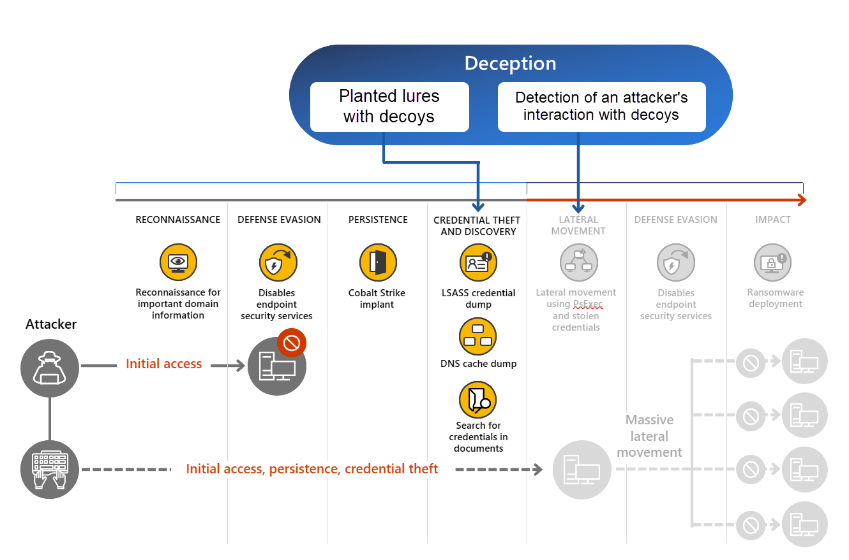
Current Tooling Evaluation
During the discovery phase you should have gained an overview of the clients current security tooling and any deception tooling or capabilities they already have in place.
The client may be unaware of deception capabilities in their existing tooling, for example Microsoft Defender XDR has a deception feature built in that allows you to create decoys of connected endpoints and create custom lures. See the image to the right.
You should take your time to review and research their tooling for any deception features or capabilities that could be easily implemented.

Slide 13
Commercial or open source?
When considering acquiring additional deception tooling you should consider both open source and commercial solutions. Your tooling search should be driven by the use cases you have developed, as there are many tools available with different capabilities. Bear in mind, clients existing tooling may already cover some of the use cases.
We have included some examples of tools in both categories. We would encourage you to research additional option based on your clients needs.
Open source: Free software available without support. Will mean more work for the client to implement and keep running.
Thinkst Canary Tokens
T-pot
Commercial: Premium tools with assisted implementation and ongoing support.
Thinkst Canary
Countercraft
Cybertrap

Slide 14
Tool Comparison
Once you have identified tools that you believe may cover your use cases, you should complete a comparison of them to determine their strengths and weaknesses. See an example table below. Other comparison factors you could consider include but are not limited to:
Attack Vector Simulations
User and Entity Behaviour Analytics (UEBA)
Deployment Options
Threat Intelligence Sharing
Category | Thinkst Canary | CounterCraft | CyberTrap | Observations
Deployment Ease | Quick setup for both physical devices and virtual. “3- minute setup” | Quoted as 5 minute setup | Guided setup with support. If using enterprise package, a specialist will install for you. | All options offer guides and advertise quick+ easy setups
Detection Capabilities | Can be customized to detect wide range of behaviours and activities |  | Advanced deception technology
Customization | Highly customisable Canaries and configurations | Highly customisable campaign creation options | High, tailored deception campaigns | All options offer high customization. CounterCraft and Canary
Integration with SIEM/Security Stack | Good integration with other tools like Splunk, Sentinel, Sophos etc. | Can be integrated into existing security stack | High, often part of a larger suite | All offer security stack integration.
Reporting and Analytics | Detailed reports provided upon canary trigger | ActiveAgent provides detailed, real time reporting | Detailed, actionable insights | All options offer detailed, real-time reporting
Support and Community | Fully supported enterprise level service | Fully supported enterprise level service | Professional support available
Cost | Annual subscription of $7500 gets you 5 canaries + Access to all canary services. | Subscription based, no pricing model available online | Subscription-based, potentially high | Will need to contact each vendor to get true value proposition

Slide 15
Success Criteria
You will need to agree with the client the criteria by which you will measure the tools you are presenting to them. You should present several options to the client based on this criteria. Below are some key criteria by which the deception solution can be chosen. This list is not exhaustive and may be different depending on the specific requirements for your client.
1
How many of the defined use cases are met
Ease of deployment: Resources required? Time to deploy?
True positive vs false positive ratio
Support included: Any dedicated resources? Tool configuration for custom use cases? Integration assistance?
Integration with existing tools and security stack
Quality of the tools dashboard and information included in reporting
Impact on existing network (Bandwidth etc.)
2
3
4
5
6
7

Slide 16
Costs
The cost of implementing a deception tool will be important when the client is deciding on the options you present. You should complete an estimated cost breakdown for the tools you are presenting. This will not just include the price of purchasing a tool, but the implementation and ongoing running costs. Below we have included some example breakdowns of costs.
Remember to consider the infrastructure cost, your client may want to host the tool on prem, or using a different cloud vendor. The infrastructure costs will also differ wildly based on the requirements for the both your specific use cases and the tools you are presenting for consideration.
Procurement: Cost of acquiring the tool
Vendor | Tool cost
Cybertrap | $50 per endpoint per year + $5000 for AWS hosted platform. Can host on your own infrastructure to avoid platform charge
CounterCraft | $50,000 a year (online estimate)
Thinkst Canary | $7500 a year for 5 Canaries and platform + $1000 for each additional canary Total of $27500 for 25 Canaries
Azure Infrastructure Cost
Item and amount | Estimated Monthly Cost
25 x VM’s | $1000 dollars monthly if reserved for a year. $1500 if PAYG.
1 x Hot Storage account | $52
1 x Cold Storage account | $38
2x Vnet’s | $4
10 x Public IP’s | $26
2 x Azure firewalls | $1825
1 x Express Route | $55
1 x Network Watcher | Free (if stay within monthly use limit)
1 x Load Balancer | £23
1x Application Gateway | $51
1 x Microsoft Entra ID (AD) | $307
Total Monthly Cost | $3431
Resourcing hours
Initial implementation: 5- 6 months | Running: 1 year
Security architect 1 resource for design + review Total: 20 hours Security Engineer 1 resource Total: 40 hours | 1 full time analyst 8 hours a week Total: 416 hours annually

Slide 17
4. Implementation

Slide 18
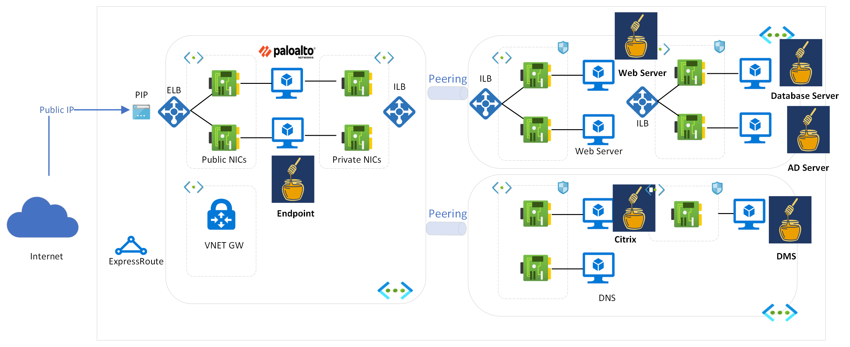
The Azure Sandbox environment can be used for the POC to deploy honeypots and honeytokens such as honeypot :
DMS solution
SMB File share Server
AD
Endpoint
WAF
DB
Citrix Server
Web Server
The honeytokens which we can used are:​
User accounts​
Service Accounts​
File decoys​
API Secrets​
Honeypots such as the Citrix, SMB, Endpoint honeypot can be external facing and the other honeypots can be deployed internally (which can capture lateral movement alerts).​
The honeytokens will be distributed on the honeypots depending on the type of honeypot. ​
​

Slide 19
Option 3 - Indicative Approach and Timeline
The full implementation of Option 3 will require three phases of work to be delivered by the Security and wider Technology teams.
Overall Phase 1, 2 & 3
Phase 1:
Phase 2:
Production for Pilot Landing Zones
Phase 3:
Wider Implementation Across Network
Initial
Implementation (POC)
Activities:
Identify network landing zones/areas where the solutions can be placed
Determine type of decoys and lures to be placed on network
Identify process of alerting and steps to integrate solution. Develop required documentation
Fine tuning of false positives/exclusions required
Integration with threat intel and XDR solutions
Activities:
Involve network ops team, architects, application owners to gain permissions to deploy solution.
Create mapping of network regions of where decoys and lures should be placed.
Begin deployment of decoys and lures by TVM team. Assist in coordinating deployment + troubleshooting
Use processes identified in phase 2 and make any changes required in process documents and day to day operations.
Fine tuning of alerting, creating more alerts, decoys and lures as required.
Integration of alerting into threat intel and XDR, performing any required troubleshooting.
Activities:
Finalising network diagram and use cases
Loop in TVM/Rob with commercial vendors for POC
Creation of network by NetOps
Kickoff POC
Aggregation of results from commercial tools + defender
Planning and Mobilisation
Outputs required:
Use cases
Network architecture for POC
POC and POV for commercial solutions + defender
• Pilot results for deception technologies
Outputs required:
Alerting and solution integration documentation
Pilot planning completed
Outputs required:
Deployment of deception technology across wider network
Creating process flow for monitoring and refinement of the process
Estimated Time: 3-4 weeks
Estimated Time: TBD based on POC
Estimated Time: TBD based on POC
Notes:
TM Governance Committee
Define the Threat Modelling and Guardrail Strategy and ensure alignment to the wider CISO and Enterprise Architecture Strategies
Define standards and definitions for threat models and guardrails, enabling federation to other teams.
Deliver and maintain a scalable Compliance Framework for use by the organisation
Manage demand for threat modelling and guardrail curation
Proactively TM products using data from cloud platforms to identify what products are being used
Developers:
Capture local demand Threat Models and Guardrails for management and prioritisation
Be security aware and meet configuration requirements when creating platforms and apps for the wider business
Manage demand for threat modelling and guardrail curation
Deliver and drive adoption of secure reusable patterns, with the support of security engineers
Proactively TM products using data from cloud platforms to identify what products are being used
Engage early to avoid a backlog of security tasks at the end of a project
Catalogue:
Training: Training for the DevSecOps team on how to perform threat modeling and use the tools effectively.
Consultation Services
Risk remediation recommendations: Recommendations for mitigating potential risks and vulnerabilities identified during the threat modeling exercise
Tool Access
Access to threat library

Slide 20



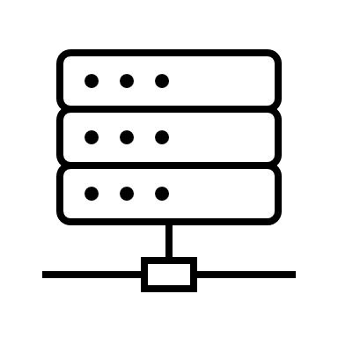






Example Network with cloud decoys
Active Directory Domain Controller
Fileserver SMB NFS FTP
DataBase Server
Webserver HTTP
Decoy AD SMB HTTP
Decoy DBMS HTTP
Decoy RDP SSH
VPN Tunnel
Desktop 1
Desktop 2
Desktop 3
Desktop 4

Slide 21
4. Key Deliverable

Slide 22
Deliverable (1/2)
The key deliverable at this stage will be a comparison of the tools you have selected for the clients consideration. This will include the success criteria you have agreed, a breakdown of costs and any other pros and cons you believe should be brought to the clients attention.
You should address each tools capabilities and the use cases they cover individually, as well as direct and detailed comparisons between the different options. A solution could be a combination of tools that the client already has in place and additional tooling to be acquired, that would fill in gaps in your use cases. Please see below an example table containing various options.
This comparison addresses the time required to implement and deploy a new solution which you should also consider when presenting your solutions to the client.
Option | Strategy | Complexity | Pre-Requisites | Required Skills | Required Resources | Cost Estimate | Pros and Cons
Option 1 | Do not implement any deception solution | None |  |  |  |  | Pros: No investment or resourcing needed, as it relies on existing security measures and compensating controls. Cons: This approach is not in alignment with complete defence in depth.
Option 2 | Implement only Microsoft Defender for Endpoint (XDR built-in deception capability) | Low | Current Microsoft Defender for Endpoint infrastructure. | Existing knowledge in Microsoft Defender and system administration. | 1 inhouse resource from security team (Up to to 2 weeks from initial POC) | Free: Defender is already in use. Feature is available using our existing licence. | Pros: Leverages defender's existing capabilities. There will be minimal disruption in the current infrastructure. It will enable quicker implementation with existing skills and no additional integration will be needed with SIEM/XDR tools. Cons: It only covers windows endpoints as a use case. There are limited use cases which are supported by defender as compared to commercial solutions.
Option 3 | Conduct a PoC (with the commercial solutions, defender) followed by Full Scope Implementation of a honeypot strategy (MDE XDR and winner PoC vendor) | High | PoC agreements, virtual machines for deployment, isolated testing network environment. Procurement of the solution. MDE XDR licenses, infrastructure for chosen honeypot solution | Security Architecture Security Engineering Security Analyst | Implementation (1-2 POC and 5-6 month for deployment): Security architecture: 1 resource to create the HLD and LLD designs for the deployment of the solutions. Security Engineering- To create the network architecture and deploy the use cases. Operations : 1 FTE resource addition to look at the triggered alerts, finetuning of the alerts and processes. | Procurement cost: $20,000 – $50,000 | Pros: The commercial solutions will enable usage of comprehensive deception technologies such as decoys, lures, fake networks etc a for wide variety of attack surfaces within the existing infrastructure. These solutions provide a wide range of threat use cases which maps to various stages of an attack. Cons: The time, effort and cost required to implement and run these deception technologies will be high and will require dedicated resources. Further integrations will need to be done for these solutions with existing tooling and processes.
 |  |  |  |  |  | Resource cost: Implementation: 60 hours * per hour resource cost Resource cost: Operations: 416 hours * per hour resource cost
 |  |  |  |  |  | Infrastructure cost: $3431 Monthly $ 41,172 Annually

Slide 23
Deliverable (2/2)
Below is another example of an important comparison to include in the deliverable. This table lists the critical use cases to be covered by the deception solutions and which of the tools are able to meet them. An ideal solution will cover all use cases but you may need to present a combination of them to client to cover all the agreed use cases
ID | Use Case | Attack Surface/Asset | Tool | Deception Technique
POC_001 | T1048: Exfiltration over alternative protocols: Adversaries may steal data by exfiltrating it over a different protocol than that of the existing command and control channel. | DMS | Thinkst CounterCraft Cybertrap | Decoy Data Responses
POC_002 | TA0008: Lateral movements, Remote code execution: Consists of techniques that adversaries use to enter and control remote systems on a network. | SMB | Thinkst Cybertrap | Decoy File Shares SMB Honeypot
POC_003 | TA0004: Privilege Escalation: Consists of techniques that adversaries use to gain higher-level permissions on a system or network. | AD | Deception in Defender HoneyTokens in MDI CyberTrap Thinkst Canary Countercraft | Fake Servers (Linux, Windows) Citrix NetScaler Server Honeypot
POC_004 | T1558.003: Kerberoasting: Adversaries may abuse a valid Kerberos ticket-granting ticket (TGT) or sniff network traffic to obtain a ticket-granting service (TGS) ticket that may be vulnerable to Brute Force. | AD | CyberTrap Thinkst Canary Countercraft | Decoy User Accounts Fake user/service accounts and credentials
POC_005 | TA0003: Host compromise and persistence : Consists of techniques that adversaries use to keep access to systems across restarts, changed credentials, and other interruptions that could cut off their access. | AD | MDI | Honeytokens
 |  | Endpoints | Defender | Basic lures
 |  | Endpoints | Defender | Advanced lures
 |  | Endpoints | Defender | Decoys
POC_006 | T1190: Adversaries may attempt to exploit a weakness in an Internet-facing host or system to initially access a network. The weakness in the system can be a software bug, a temporary glitch, or a misconfiguration. | EASM | CyberTrap Thinkst Canary Countercraft | Decoy web server

Slide 24
Note
Use this end slide for all marketing and other general materials.
The audited entities disclaimer at the top in bold should be included on all materials that discuss any of KPMG’s non-audit services, for both internal and external distribution.
The disclaimer must remain in a visible location and in same font size as content within the document. Do not place it within the footer or as part of the other KPMG copyright and disclaimer statements.
Delete this box when completed
Some or all of the services described herein may not be permissible for KPMG audited entities and their affiliates or related entities.
kpmg.com/uk
The information contained herein is of a general nature and is not intended to address the circumstances of any particular individual or entity. Although we endeavour to provide accurate and timely information, there can be no guarantee that such information is accurate as of the date it is received or that it will continue to be accurate in the future. No one should act on such information without appropriate professional advice after a thorough examination of the particular situation.
KPMG Law is part of KPMG LLP, a multi-disciplinary practice authorised and regulated by the Solicitors Regulation Authority. SRA ID: 615423. For full details of our professional regulation please refer to ‘Regulatory information’ under ‘About’ at www.kpmg.com/uk [Include this statement only for KPMG Law/Legal services documents. Delete otherwise.]
© 2024 KPMG LLP, a UK limited liability partnership and a member firm of the KPMG global organisation of independent member firms affiliated with KPMG International Limited, a private English company limited by guarantee. All rights reserved.
The KPMG name and logo are trademarks used under license by the independent member firms of the KPMG global organisation.

Slide 25
Estimated cost breakdown of full implementation (Option 3)
Procurement: Cost of acquiring the tool
Vendor | Tool cost
Cybertrap | $50 per endpoint per year + $5000 for AWS hosted platform. Can host on your own infrastructure to avoid platform charge
CounterCraft | $50,000 a year (online estimate)
Thinkst Canary | $7500 a year for 5 Canaries and platform + $1000 for each additional canary Total of $27500 for 25 Canaries
Azure Infrastructure Cost
Item and amount | Estimated Monthly Cost
25 x VM’s | $1000 dollars monthly if reserved for a year. $1500 if PAYG.
1 x Hot Storage account | $52
1 x Cold Storage account | $38
2x Vnet’s | $4
10 x Public IP’s | $26
2 x Azure firewalls | $1825
1 x Express Route | $55
1 x Network Watcher | Free (if stay within monthly use limit)
1 x Load Balancer | £23
1x Application Gateway | $51
1 x Microsoft Entra ID (AD) | $307
Total Monthly Cost | $3431
Resourcing hours
Initial implementation: 5- 6 months | Running: 1 year
Security architect 1 resource for design + review Total: 20 hours Security Engineer 1 resource Total: 40 hours | 1 full time analyst 8 hours a week Total: 416 hours annually

Slide 26
Different Strategy Options for Deployment of Deception Technology
After considering current toolset and conducting workshops with several premium vendors, we are presenting a range of options to choose from
Option Number | Strategy | Complexity | Pre-Requisites | Required Skills | Required Resources | Cost Estimate | Pros and Cons
Option 1 | Do not implement any deception solution | None |  |  |  |  | Pros: No investment or resourcing needed, as it relies on existing security measures and compensating controls. Cons: This approach is not in alignment with complete defence in depth.
Option 2 | Implement only Microsoft Defender for Endpoint (XDR built-in deception capability) | Low | Current Microsoft Defender for Endpoint infrastructure. | Existing knowledge in Microsoft Defender and system administration. | 1 inhouse resource from security team (Up to to 2 weeks from initial POC) | Free: Defender is already in use. Feature is available using our existing licence. | Pros: Leverages defender's existing capabilities. There will be minimal disruption in the current infrastructure. It will enable quicker implementation with existing skills and no additional integration will be needed with SIEM/XDR tools. Should Cons: It only covers windows endpoints as a use case. There are limited use cases which are supported by defender as compared to commercial solutions.
Option 3 | Conduct a PoC (with the commercial solutions, defender) followed by Full Scope Implementation of a honeypot strategy (MDE XDR and winner PoC vendor) | High | PoC agreements, virtual machines for deployment, isolated testing network environment. Procurement of the solution. MDE XDR licenses, infrastructure for chosen honeypot solution | Security Architecture Security Engineering Security Analyst | Implementation (1-2 POC and 5-6 month for deployment): Security architecture: 1 resource to create the HLD and LLD designs for the deployment of the solutions. Security Engineering- To create the network architecture and deploy the use cases. Operations : 1 FTE resource addition to look at the triggered alerts, finetuning of the alerts and processes. | Procurement cost: $20,000 – $50,000 | Pros: The commercial solutions will enable usage of comprehensive deception technologies such as decoys, lures, fake networks etc a for wide variety of attack surfaces within the existing infrastructure. These solutions provide a wide range of threat use cases which maps to various stages of an attack. Cons: The time, effort and cost required to implement and run these deception technologies will be high and will require dedicated resources. Further integrations will need to be done for these solutions with existing tooling and processes.
 |  |  |  |  |  | Resource cost: Implementation: 60 hours * per hour resource cost Resource cost: Operations: 416 hours * per hour resource cost
 |  |  |  |  |  | Infrastructure cost: $3431 Monthly $ 41,172 Annually

Slide 27
Use cases
ID | Use Case | Attack Surface/Asset | Tool | Deception Technique | Status
POC_001 | T1048: Exfiltration over alternative protocols: Adversaries may steal data by exfiltrating it over a different protocol than that of the existing command and control channel. | DMS | Thinkst CounterCraft Cybertrap | Decoy Data Responses
POC_002 | TA0008: Lateral movements, Remote code execution: Consists of techniques that adversaries use to enter and control remote systems on a network. | SMB | Thinkst Cybertrap | Decoy File Shares SMB Honeypot
POC_003 | TA0004: Privilege Escalation: Consists of techniques that adversaries use to gain higher-level permissions on a system or network. | AD | Deception in Defender HoneyTokens in MDI CyberTrap Thinkst Canary Countercraft | Fake Servers (Linux, Windows) Citrix NetScaler Server Honeypot
POC_004 | T1558.003: Kerberoasting: Adversaries may abuse a valid Kerberos ticket-granting ticket (TGT) or sniff network traffic to obtain a ticket-granting service (TGS) ticket that may be vulnerable to Brute Force. | AD | CyberTrap Thinkst Canary Countercraft | Decoy User Accounts Fake user/service accounts and credentials
POC_005 | TA0003: Host compromise and persistence : Consists of techniques that adversaries use to keep access to systems across restarts, changed credentials, and other interruptions that could cut off their access. | AD | MDI | Honeytokens
 |  | Endpoints | Defender | Basic lures
 |  | Endpoints | Defender | Advanced lures
 |  | Endpoints | Defender | Decoys
POC_006 | T1190: Adversaries may attempt to exploit a weakness in an Internet-facing host or system to initially access a network. The weakness in the system can be a software bug, a temporary glitch, or a misconfiguration. | EASM | CyberTrap Thinkst Canary Countercraft | Decoy web server

Slide 28
Honeypot: Approach by Area
DMS
Understand the data flow in Imanage
Carry out threat modelling to understand which attacks can be performed
Determine where within the network to deploy honeypots
Create believable lures and determine where to place them within the network
Implement within sandbox environment for testing
AD
Understand A&O’s active directory and user accounts e.g. the type of accounts used, naming conventions, age of accounts, age of passwords etc and create a Threat Model for it.
Determine set of characteristics to make Decoy accounts believable to an attacker.
Implement honeypot or decoy AD accounts within a sandbox environment for testing
SMB, Endpoints, Network Devices, DB
Understand most common SMB protocols being used by attackers such as NTLM relay attacks, EternalBlue or SMBLost, SMB enumeration , RCE V2, 3(CVE-2020-0601, CVE-2020-0796 , SMBGhost SMBv3 Remote Code Execution Vulnerability. TTPs on Endpoints (User accounts, Access of sensitive files, Registry changes etc.) and a WAF( to detect Known Vulnerabilities Signatures , Trojan/Backdoor Access 4 Outbound Data Leakage 4 Anti-Virus and DoS utility scripts)
Deploy Honeypots or deception techniques to mimic these protocols and capture the attackers traffic.

Slide 29
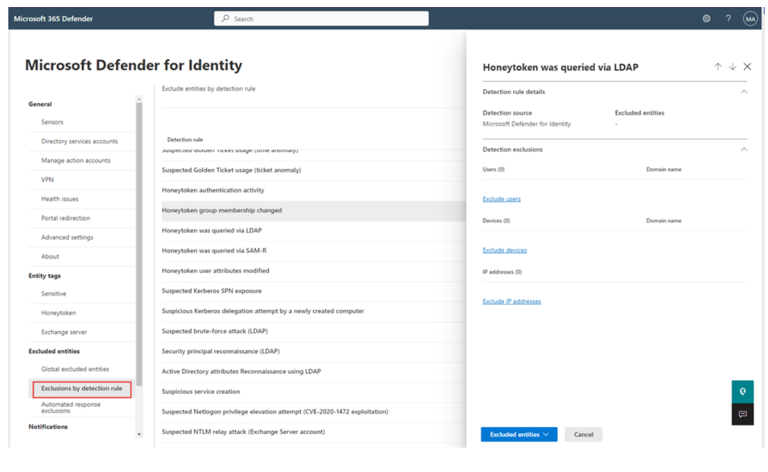
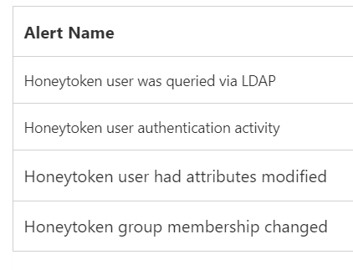
A1. Identity Based Honeytokens in MDI
Types of Honeytokens:
User Accounts
Service Accounts
Placement of Honeytokens:
SharePoint Site (file listed as passwords)
Code Repositories
Mapped Drives
Local documents

